Slide 1
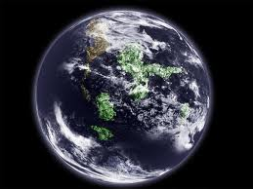
BE IMMERSED IN HUMAN REALITY
AND BE A TRANSFORMING PRESENCE
Notes:
In our theme, we see the already and the not yet. This is who we are. If so many different places around the world we are immersed in human reality in significant ways, desiring to be a transforming presence. As we begin this day together, I invite you to be in silence with our own experience, and with the experience of our province. When have you experienced being deeply immersed in human reality in a way that felt somehow significant? What do you notice?

Slide 2
Where do we place ourselves?
Notes:
Religious life was not always encouraged to be immersed in human reality. In the 1800s when most of our congregations of apostolic religious life were founded, it was a new thing to break out of the cloister. Our congregation was one of the early experiences of that, founded in 1844. Religious life before that was quite defined by the theology of the Council of Trent, dating from the mid 1500s.

Slide 3
Religious life is a mystical- prophetic life form.

Slide 4

“Mysticism and prophecy belong to the genetic codes of our identity and our mission for the
Kingdom of God.”
Bruno Secondin O. Carm UISG
Notes:
We must see them together. Particularly, it would be a distortion to see mysticism as opposed to fruitful action, which is the tendency of some, given the importance of our individual and collective work for justice on a global scale.
In our lifetimes, religious around the world have come to realize our vocation is a special gift to the church. We have come to a new clarity about our identity: Religious life is to be mystical and prophetic-----that is the core of who we are for the church and the world.

Slide 5
True prophets arise and remain authentic through a special mystical experience of God which marks, sustains, and consoles them in moments of crisis.
Bruno Secondin

Slide 6
An authentic mysticism, as an encounter with the living God, lover of life, cannot but nourish and express itself in bold and liberating prophetic action.
Notes:
Every time a new form of religious life emerged in history it had these characteristics.
Therefore we can conclude that religious life is a mystical- prophetic life form.

Slide 7
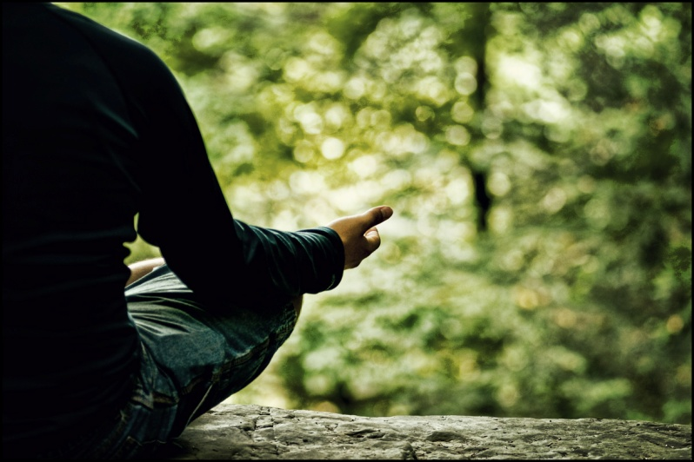
Mystic
“A person who is deeply aware of the powerful presence of the Divine Spirit; someone who seeks, above all, the knowledge and love of God and who experiences to a strong degree the profoundly personal encounter with the energy of divine life.”
Ursula King

Slide 8

A mystic is someone who lights the candle and cries for joy,
crazy in love with No One.
A mystic doesn’t argue about God defend God, or crusade for God

Slide 9
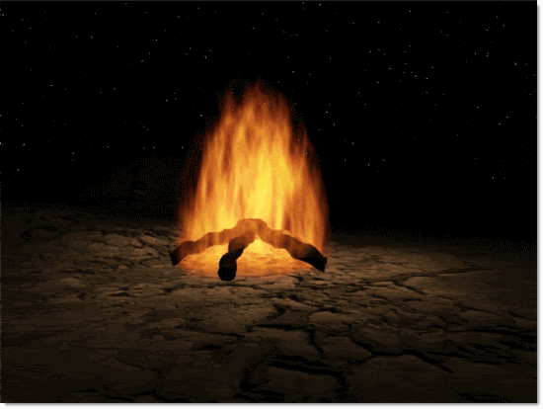
“A mystic is a burning bush, A spark of the Holy Bonfire, The one in the corner who is laughing at Nothing ..
Don’t look for bruised knees, bowed heads, hands claped or beating breasts ….”
Jan Philips

Slide 10
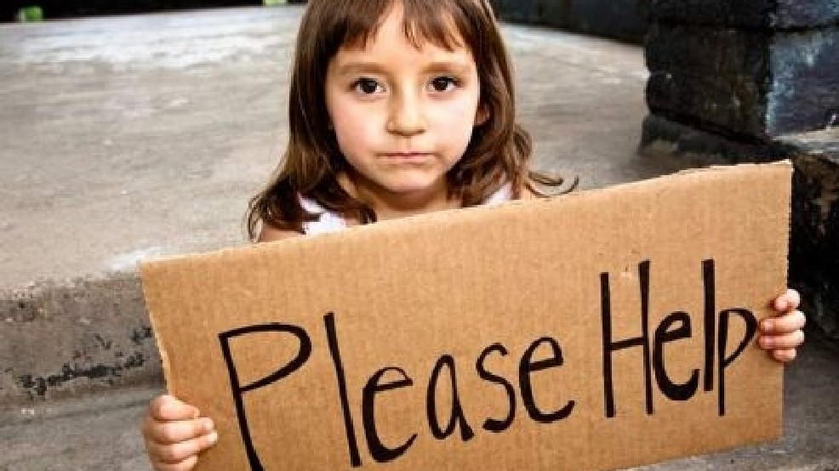
Prophet:
someone who is Immersed in the life of the people in a particular time and place
Interprets that situation in the light of God’s dream for humanity.
Notes:
Holding to a vision of how it will be is the business of prophetic faith. It is a key mark of Israel's prophets that they held to a vision of an alternative world in season and out of season. And they could hold to such a deep and abiding hope precisely because they understood that the new alternative to come was not to be derived from the present circumstance.

Slide 11

“The prophets were more than social critics. They were holders to a vision rooted in nothing other than God’s promise. In the very midst of the hopelessness of defeat and inescapable judgment, they continue to articulate an alternative vision for the future”. Brueggemann

Slide 12
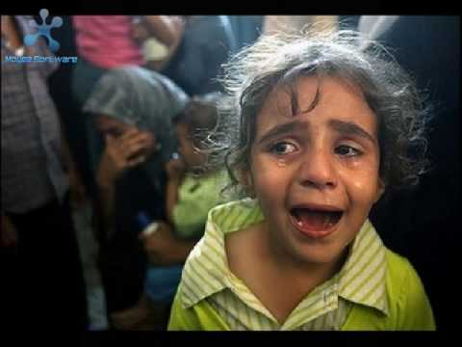
“Indeed their emotional life was very much in response to the ache they saw in the world around them. But they never confused present possibilities with divine impossibility”.
Brueggemann

Slide 13
MYSTICISM OF OPEN EYES

Slide 14
Pope Francis – Year of Consecrated life:
“Consecrated men and women are called to live the charism of prophecy. Prophets receive from God the ability to scrutinize the times in which they live and to interpret events; they are like sentinels who keep watch in the night and sense the coming of the dawn.

Slide 15
Prophets know God and they know the men and women who are their brothers and sisters. They are able to discern and denounce the evil of sin and injustice. Because they are free, they are beholden to no one but God, and they have no interest other than God. Prophets tend to be on the side of the poor and powerless, for they know that God ‘himself’ is on their side”.

Slide 16
In religious life we need to reflect, not only in terms of what we do… but
What we believe about the Reign of God
Where we live - where we locate ourselves
How we live together
How we understand the vows.
How we read the scripture
Spirituality
Vision of church
Understanding of the world
How we prepare people for future ministry – what ministry will be needed.
How we see ourselves in relation to the planet / cosmos
Others….

Slide 17

“The world needs contemplative women (men) who see the world as God sees the world and so critique any system, either church or state, that denies any people the fullness of creation”.
Chittister

Slide 18

To be a religious today is to live in a certain moral loneliness. It is to be what sociologists term a “cognitive minority,” that is, to be religious today is to stand outside of the dominant consciousness.
Ron Rolheiser OMI

Slide 19
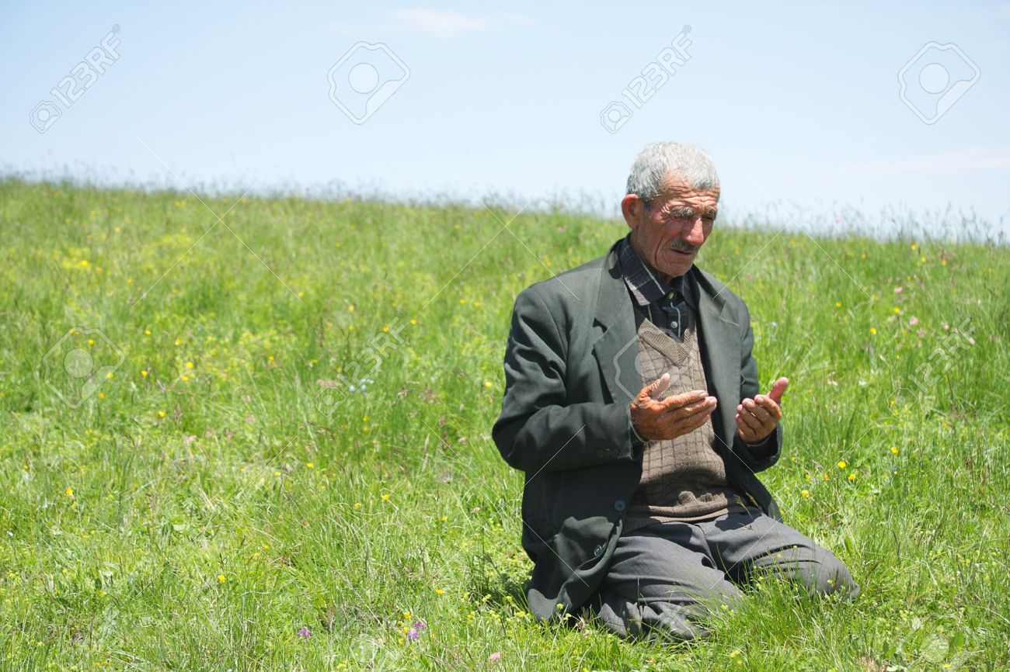
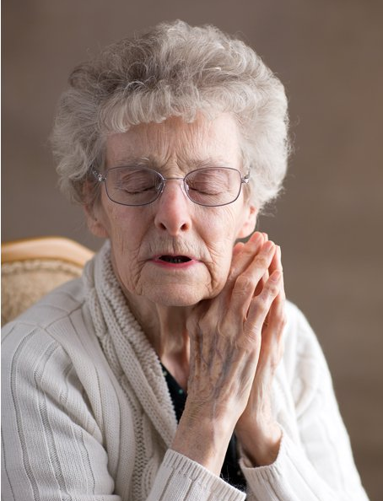
What are the gifts we now have to give…
What kind of energy are we “putting into the universe?”
We don’t need
numbers for this role…

Slide 20
“If the inner work is puny, the outer work will never be great and if the inner work is great the outer work will never be puny..” Eckhart

Slide 21

“A half hour meditation is essential –except when you are very busy,
then a full hour is needed”.
Francis de Sales

Slide 22

Mystical - Prophetic.
Twins who need each other

Slide 23
Pope Francis invites us to
the geographical
as well as existential margins.

Slide 24
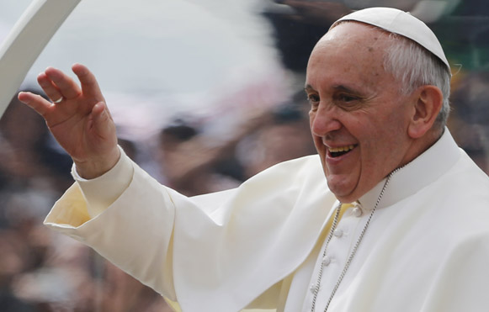
Pope Francis: Consecrated life
Religious must “never be rigid or closed, but always open to the voice of God who speaks, who opens and who leads
and invites us to go out toward
the horizon.”

Slide 25
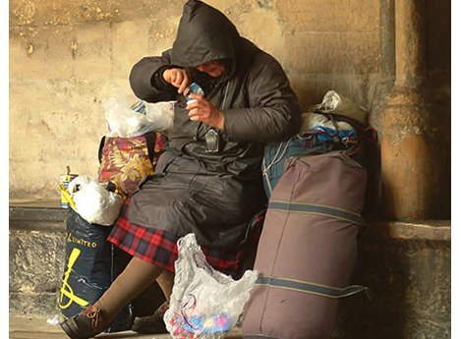
“Religious families are born to inspire new journeys, suggest unforeseen routes, or respond nimbly to human needs and necessities of the spirit”.
Pope Francis

Slide 26
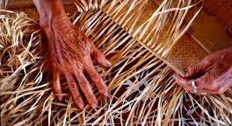
“The joy of the gospel calls us to weave a spirituality like a type of searching, exploring alternative metaphors and new images, and creating unprecedented perspectives.” Pope Francis

