Slide 1
HOLY CROSS SISTERS
GENERAL CHAPTER
MESSAGE 2019
********
SISTERS DE CRUZ SANTA CAPÍTULO GENERAL
MENSAJE 2019

Slide 2
The central point of the message is:
Rooted in Christ…
to be a transforming presence
El punto central del mensaje es:
Arraigado en Cristo...
para ser una presencia
transformadora
Notes:
Theme of the chapter …..
Let us begin together steeped in a contemplative spirit ….
“Let us entrust ourselves to the Presence of God Who dwells within us and around us, individually and collectively. …….
Let us welcome the Presence of God Who invites us to a profound engagement with matters that matter, not with ego needs. ……..
Let us confide ourselves to the Spirit of God Who illuminates the false securities and domesticating ideologies that seduce and lead us away from the work at hand ………..
Let us open our hearts to the Spirit of God who graces us to surrender incapacitating habits of mind and heart…. ….

Slide 3
Transforming presence
Transformar la presencia

Slide 4
"A reform must first transform the interior and then unfold from within to the outside. One who wants to change the society must first change oneself. Then one can reform the single members so that the Divine lives in them and then speaks and acts through them. Then the society will soon be changed."
(Theodosius Florentini, Life of the Saints vol 4, 28-30)
"Una reforma debe transformar primero el interior y luego desarrollarse desde dentro hasta el exterior. El que quiere cambiar la sociedad primero debe cambiarse a sí mismo. Entonces uno puede reformar a los miembros solteros para que la Divina viva en ellos y luego hable y actúe a través de ellos. Entonces la sociedad pronto cambiará".
(Teodosiano Florentini, Vida de los Santos vol 4, 28-30)
Notes:
Do we need a reform? Do you believe that there is a divine presence in each one of us?

Slide 5
Rooted in Christ…to be a transforming presence
THIS IS MY CALL - THIS IS OUR CALL
to immerse in human reality and to be TRANSFORMING PRESENCE in our context today.
****************
Arraigado en Cristo... para ser una presencia transformadora
ESTA ES MI LLAMADA - ESTA ES NUESTRA LLAMADA
para sumergirse en la realidad humana y estar TRANSFORMANDO LA PRESENCIA en nuestro contexto de hoy.

Slide 6
Living the Paschal Mystery transforms us to become His presence in our changing and challenging world.
Vivir el misterio pascual nos transforma para convertirnos en Su presencia en nuestro mundo cambiante y desafiante.
Our whole way of life is deeply rooted in God, Mk. 3:14.
The contemplative dimension in its fullest understanding will permeate all aspects of formation.
Toda nuestra forma de vida está profundamente arraigada en Dios, Mc. 3:14.
La dimensión contemplativa en su totalidad comprenderá todos los aspectos de la formación.
Notes:
MK.3:14 “And He appointed twelve, whom He has named apostles, to be with Him, and to be sent out to proclaim the message”
St. Teresa answers: 'Contemplative prayer [oración mental] in my opinion is nothing else than a close sharing between friends; it means taking time frequently to be alone with him who we know loves us.' Contemplative prayer seeks him 'whom my soul loves'. It is Jesus, and in him, the Father.

Slide 7
MISSION TODAY We seek to bring new life in the face of death; fullness of life to ourselves, to others, and to our common home, John 10:10.
By our contemplative and prophetic life we seek to immerse ourselves among the people on the margins of society.
Buscamos dar nueva vida a la muerte; plenitud de la vida a nosotros mismos, a los demás y a nuestro hogar común, Juan 10:10.
Por nuestra vida contemplativa y profética buscamos sumergirnos entre el pueblo al margen de la sociedad.
Notes:
Jn 10:10 “The thief comes only to steal and kill and destroy. I came that they may have life, and have it abundantly”

Slide 8
Answering the need of the time, in our respective contexts, together we live the Holy Cross Charism.
Respondiendo a la necesidad del tiempo, en nuestros respectivos contextos, juntos vivimos el carisma de la Santa Cruz.

Slide 9
We cultivate the consciousness of belonging together in our diversity.
Cultivamos la conciencia de pertenecer juntos en nuestra diversidad.
Collaboration and networking brings strength to our ministries. La colaboración y el trabajo en red aportan fuerza a nuestros ministerios.
We are transformed and transforming by our national and international collaboration. Nos transformamos y transformamos con nuestra colaboración nacional e internacional.

Slide 10
As co-creators we embrace God’s creation, and in solidarity we take measures to live sustainably.
Como co-creadores abrazamos la creación de Dios, y en solidaridad tomamos medidas para vivir de manera sostenible.
In the globalisation of our world we commit ourselves to promote justice, mercy and equality.
la globalización de nuestro mundo nos comprometemos a promover la justicia, la misericordia y la igualdad.

Slide 11
We looked at five areas that are central to our growth as congregation:
Identity and Mission
Formation and Transformation
Leadership and transformation
Ecology and sustainability
Internationality and collaboration
Cinco áreas que son fundamentales para nuestro crecimiento
como congregación:
1. Identidad y Misión
2. Formación y Transformación
3. Liderazgo y transformación
4. Ecología y sostenibilidad
5. Internacionalidad y colaboración

Slide 12
We explored the challenges and risks of living out each of these areas in our mission today:
Exploramos los desafíos y riesgos de vivir cada una de estas áreas en nuestra misión hoy en día:

Slide 13
FORMATION AND LEADERSHIP Formation is a life long process.
Our whole way of life is deeply rooted in Christ.
A holistic approach inspires a continuous transformation of mind, heart and will.
'May Jesus live in our hearts.‘ (Mother Bernarda)
Leadership qualities are fostered through continuous formation. We are called to be servant leaders in God‘s Kingdom, John 13
Our secularised world calls for our transforming presence.

Slide 14
Living the Kingdom of God radically, we uphold the rights and dignity of each person, attentive to safeguarding policies in our care of the vulnerable.
We value social media and promote its healthy use to unite worldwide communion around the Holy Cross Charism. “…remember,
I am with you always, to the end of the ages”. Mt 28:20b

Slide 15
The message from Sr. Telma (from the Chapter report:
That we, Holy Cross Sisters,
be transforming presence in this world!
Surge forth into the peripheries,
Invest in peace and care for Mother Earth
And ultimately be contemplative women!
To spread the JOY of the Gospel.
The General Chapter 2019 invites us to take to heart this aspiration
Notes:
I hope you remember the chapter report came from CLT dated July 11th. ….

Slide 16
Transforming presence
a future rising from within …….
Notes:
What do you mean by transforming presence …. Short discussion

Slide 17
Jesus and the spirit of TRANSFORMATION
Jesus has the ability to TRANSFORM the world
He TRANSFORMED the world while He TRANSFORMED Himself
He discovered in Him new meanings for the world. This is how he could identify His body with the Temple of God
He spoke about His resurrection; “Destroy this temple, I shall restore it within three days (Jn 2:19)

Slide 18
Jesus reveled and realized in Him the TRANSFORMING spirit
The spirit gave Him a new presence in the world
By the power of the Spirit He became the Lamb of God who takes away the sin of the world (Jn 1:29)
As the sacrificial lamb He became a sign of liberation and salvation to the people.
Jesus TRANSFORMED the meaning of power into service

Slide 19
He is the good shepherd who lays down the life for the sheep (Jn 10: 15)
Jesus is the bread broken for the world (Jn 6:41)
Jesus is the source of living water and insisted the disciples to abandon the wells and go in search of eternal springs (Jn 4:10-15).
Our Mission is “go and tell others what you have seen and heard” with TRANSFORMED lives to TRANSFORM the world.

Slide 20
Let us Pause and ask ..
Who are we?
Where are we now?
Weaving together circumstances through which the Spirit moves here and now
Notes:
Each of us carries with us a whole world, made present in our shared presence.
Each one of us is part of a larger design. No one is here by mistake. (Pause to look around and be in touch with gratitude and appreciation of each one).

Slide 21
We have Immersed in human reality;
It is a transforming presence.
It is a reality for us because we are experiencing it in our daily life.
We have been transformed over the years by the divine transforming presence and our presence has been transforming.
Yet this is also emerging, in process. It is both ‘an already’ and ‘a not yet’.

Slide 22
It is something we already are and we desire to be.
Chapter chose this as a theme for the next six years.
It is an intentional decision to live that with greater depth and intensity.
What we choose, design, create as a Congregation/Province for the years to come will help us to live into this?
Notes:
For the next six years … we will concentrate on this theme..

Slide 23
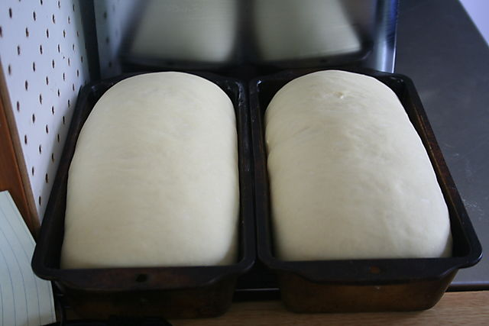
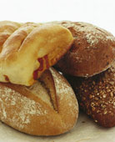
Mt. 13:33
Future rising from within ….
Are you the yeast or the bread?
Notes:
What do these images suggest to you about yourselves? Are you the yeast or the bread? (both/and)
What do these images suggest to you about transforming presence? What is the movement? (unfolding from within)
“The kingdom of heaven is like yeast that a woman took and mixed in with three measures of flour until all of it was leavened.

Slide 24
Transformation
We have experienced death to be a Transforming Presence amidst human realities
Notes:
Transformation is a process we participate in as co-creators; participative consciousness; We don’t have to try so hard to make things happen.
There is in each of us an indwelling presence, an innate wisdom, a heart knowing which is deeper than what is accessible to the rational mind. That presence, wisdom and knowing is Love. It is given. It is always available to us, a guide drawing us reliably into the movement of an evolving future whose direction is largely invisible. To allow ourselves to be led by such inner wisdom is a contemplative skill, or rather a given capacity which deepens as we open to it: that of an awakened heart.

Slide 25
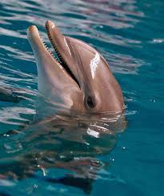
Life is more than what we see on the surface, and those who have ears to hear and eyes to see can grasp something deeper than what we see on the surface.

Slide 26
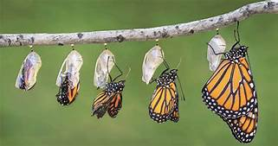
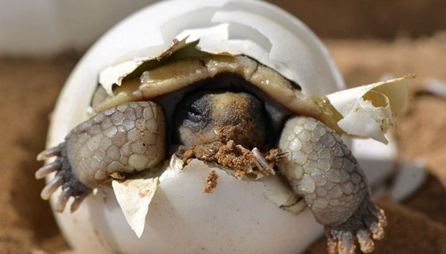
The future is emerging from within …
Notes:
If we read the Gospels with this perspective in mind, it is clear that Jesus lives and speaks out of this transforming presence. We hear it when he refers to his Abba, the Father. He refers often to another dimension not immediately visible, and he tries to communicate that mystery in parables, stories, concrete images..

Slide 27
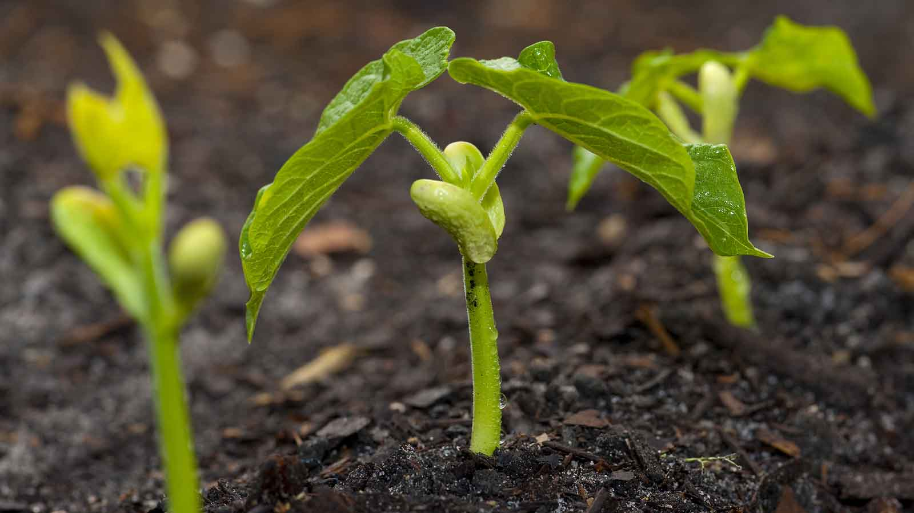
Farmer sows and the seeds just sprout, just spring up and grow from within and the inner essence of life comes out.
Notes:
Jesus knew another reality----the transforming power of love which flowed through him and can also flow through us; it flowed out of him and he channeled it to heal and to give life;
Jesus lived from a different vision-----that we are all one, that everyone belongs;
Jesus tapped into a greater source-----as he went off to solitary places to pray

Slide 28
There is One Transforming Presence.
The presence of the Divine is in everyone, in everything and is everywhere.
We live in a God-soaked universe.
That Transforming Presence is the divine indwelling within all that exists.
Incarnation, began with creation and it continues ...
Notes:
God's presence permeates our lives and activities. His song of delight reverberates throughout all he has created. As we open our ears to that song, we hear the truth of the gospel spoken to our hearts: the kingdom of God has come to us.

Slide 29
How do we live from that reality, that invisible dimension, as Jesus did?
How do we live from that inner source, that transforming presence, personally and in communities?

Slide 30
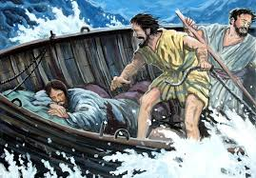
“I do not believe that we are living any more in a time of transition.
That is too tame a word to describe the upheavals taking place.
We are in a time of chaos and more than ever need to be aware of the Spirit hovering over the waters”.
Philip Pinto, cfc
Jesus in the boat with disciples.
We, of course, try to live this time with faith, with trust, with an awareness of the new that is emerging ……
These are tumultuous times.

Slide 31
We want to live into these times positively, even in the midst of loss. It entails a letting go. That might sound passive, but it is actually quite active and intentional
Since my house burnt down
I, now own a better view of the rising moon
Desde que mi casa se incendió Yo, ahora tengo una mejor vista de la luna en ascenso

Slide 32
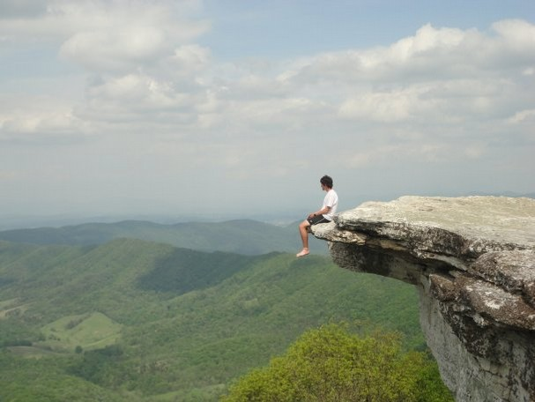
“We must be willing to constantly sit on the edge of mystery and unlearn what has helped to guide us in the past but is no longer as useful now. To do this we must be willing to ask the questions that will open us up to hear the quiet, powerful voice of freedom”.
Robert Wick

Slide 33
Large scale sorting out
of what is of the essence

Slide 34
Walking through the fog

Slide 35
It’s hard to see the whole picture when you’re
inside
the frame.

Slide 36
SHIFT!!!!
FROM Domination; hierarchy
Self-organizing systems

Slide 37
“You never change things by fighting the existing reality.
To change something, build a new model, that makes the existing model obsolete”
- Fuller

Slide 38
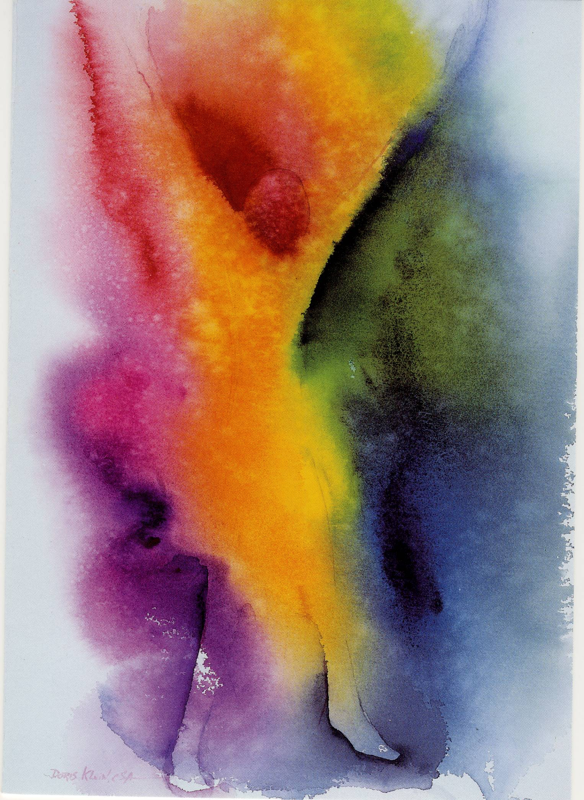
Problem – the old is not old enough to be gone, and the new is not yet new enough to be seen!

Slide 41
God comes, bidden or unbidden.

Slide 42
Contemplation
When the way forward is not clear, the way is down, within; nourish the capacity for presence, inner listening. We drop into the Indwelling Presence ….
Notes:
What is contemplation. … one day during our recollection talk the father said …… you look at him … and he looks at you …. Some times he talks … you listen … other times you talk and He listens … That is contemplation
Contemplation is the crucible where the treasure we carry in earthen vessels is purified and where God’s way unfolds from our most authentic selves.

Slide 43
The dwelling mind
This is a description of transforming presence.
We don’t analyze our way into the future, what God has in mind for us.
We dwell within the relationship with the Divine Presence, the Holy and Near One

Slide 44
Our relationship with God needs to anchor us deeply, to nourish and sustain us.
It is the most fundamental place of Transformation.
When so many external aspects of religious life are in instability, we’re thrust back onto the essential impulse of vocation, the desire for God.

Slide 45
“We might not be able to change situations, but a contemplative approach can help us change the way we enter into a situation, how we respond, how we are creating it…
The contemplative posture is one that opens us up to ambiguity, paradox, and the unknown because it releases for us a lot of our preconceived of ‘being and thinking’ and it releases us of our ego”. Nancy Sylvester
Notes:
We cannot do that of our own power. It is not the fruit of willfulness and striving. It is the gift of the Spirit who moves in us. The transformation that happens in us is, again, more like allowing, being available, surrendering to the reshaping that the Spirit brings about, usually through life as it comes to us. We can be tempted in times of loss and chaos to try harder and to do more, but what is needed is the opposite. We need to slow down and to go deeper, to carve out space and time, to be with the fertile but difficult emptiness, the deep power of letting go from which hope arises.

Slide 46
How, then, do we deepen into contemplation?
It’s about intention, about focusing our desire. Seek, ask, knock, and then trust that what we desire is deepening and emerging in us.
So, what do we DO?

Slide 47
Notice…
Discover…
Sink into…
Allow…
Open to…
Wait for…
Dwell within…
Recognize the connection to…
Be available to…
Focus attention on…
Look upon…
Ask for…
Trust in…
Breathe into…
Flow with…
OTHER?......

Slide 48
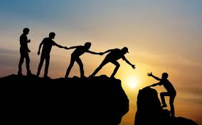
Trusting…. Surrendering….
Trust the unseen; surrender our lives, our ego, our need for results
Trust, when we ask we will receive, seek we will find, doors will be opened as needed.
Trust oneself. Trust others. Trust practices and traditions. ….

Slide 49
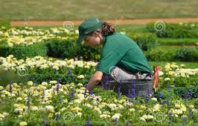
Tending
Create the conditions; listen to, be with what arises ...

Slide 50
Embodied
Focused
Attentive
Opposite of scattered And unable to be present

Slide 51
“Our role is no longer to merely ease suffering, bind up wounds, and feed the hungry, but through every form of effort to raise the powers of love upward to the next stage of consciousness.”
Teilhard de Chardin

Slide 52
“More than ever I find myself in the hands of God. This is what I have wanted all my life from my youth. But now there is a difference; the initiative is entirely with God. It is indeed a profound spiritual experience to know and feel myself so totally in God’s hands.”
Pedro Arrupe, SJ

Slide 53
There is a new urgency about that contemplation is needed now, at this moment in time.
Humanity is being drawn in this direction because at this stage of an emerging consciousness, it is what is needed now----so we can trust that it will be given.

Slide 54
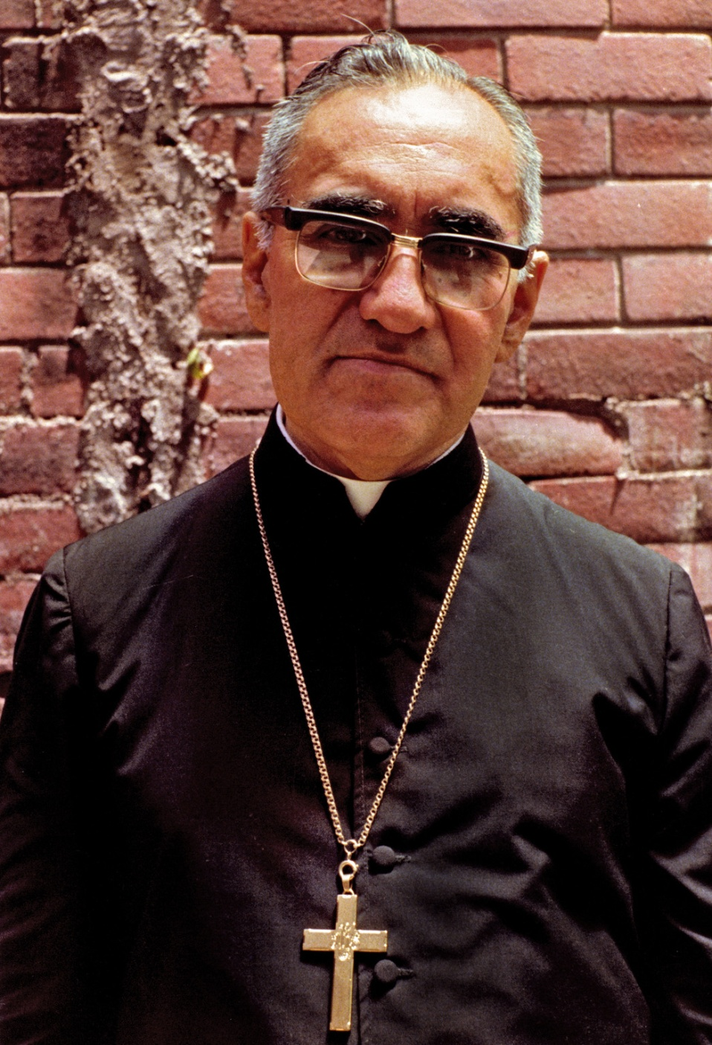
We might not like the process of letting go needed before some unknown future can arise. Nor did Oscar Romero. But As the danger to his person increased, inner peace and courage increased in the same proportion.
“It is hard for me to accept a violent death, which in these circumstances is very possible. In fact, the nuncio from Costa Rica informed me of imminent danger just this week. The unknown circumstances will be lived with the grace of God. He assisted the martyrs and if it is necessary, I will feel him very close as I give over to him my dying breath. But more important than the moment of death is the surrender of my whole life and living for him
Romero. Diary from retreat just before death:

