Slide 1
Dark clouds and light

Slide 2
That mixture of darkness and light is the reality God has created and allowed. We carry a treasure in earthen vessels. It is the simple rhythm of what it means to be human.
As human beings we cast both our light and our shadow wherever we go, in all we do. Our presence can bring both joy and suffering, to ourselves and to others.
And so we find ourselves in a world of both joy and suffering. And isn’t it our desire to be a presence that brings more joy than suffering?
We are permanently in process of movement towards wholeness and conversion.

Slide 3
Part of the darkness in and around us is our limited awareness. We see only partially.
The most common metaphor for sin in Scripture is blindness and Jesus often gives sight to the blind.
We seek a recovery of sight --- clarity and courage to see ourselves, one another, and the world with the light of deep
insight so that we can see how we are to walk together into the future.

Slide 4
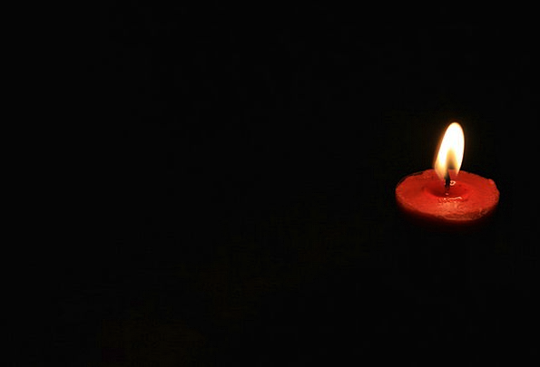
Act upon the little light you have --
and more will be given. John Shea
Notes:
That path of death and life, so inseparable and marvelously joined, is the way of Jesus and it is deeply imbedded in the experience of the universe and of our lives. Romans chapter 8 tells us that all creation is groaning in one great act of giving birth. Death and resurrection is the cosmic pattern of growth. The universe and a new human consciousness are coming to birth, painfully. Seeds fall into the ground to die and bring forth new life. We move forward with acceptance and creativity as well as with resistance and push-back

Slide 5
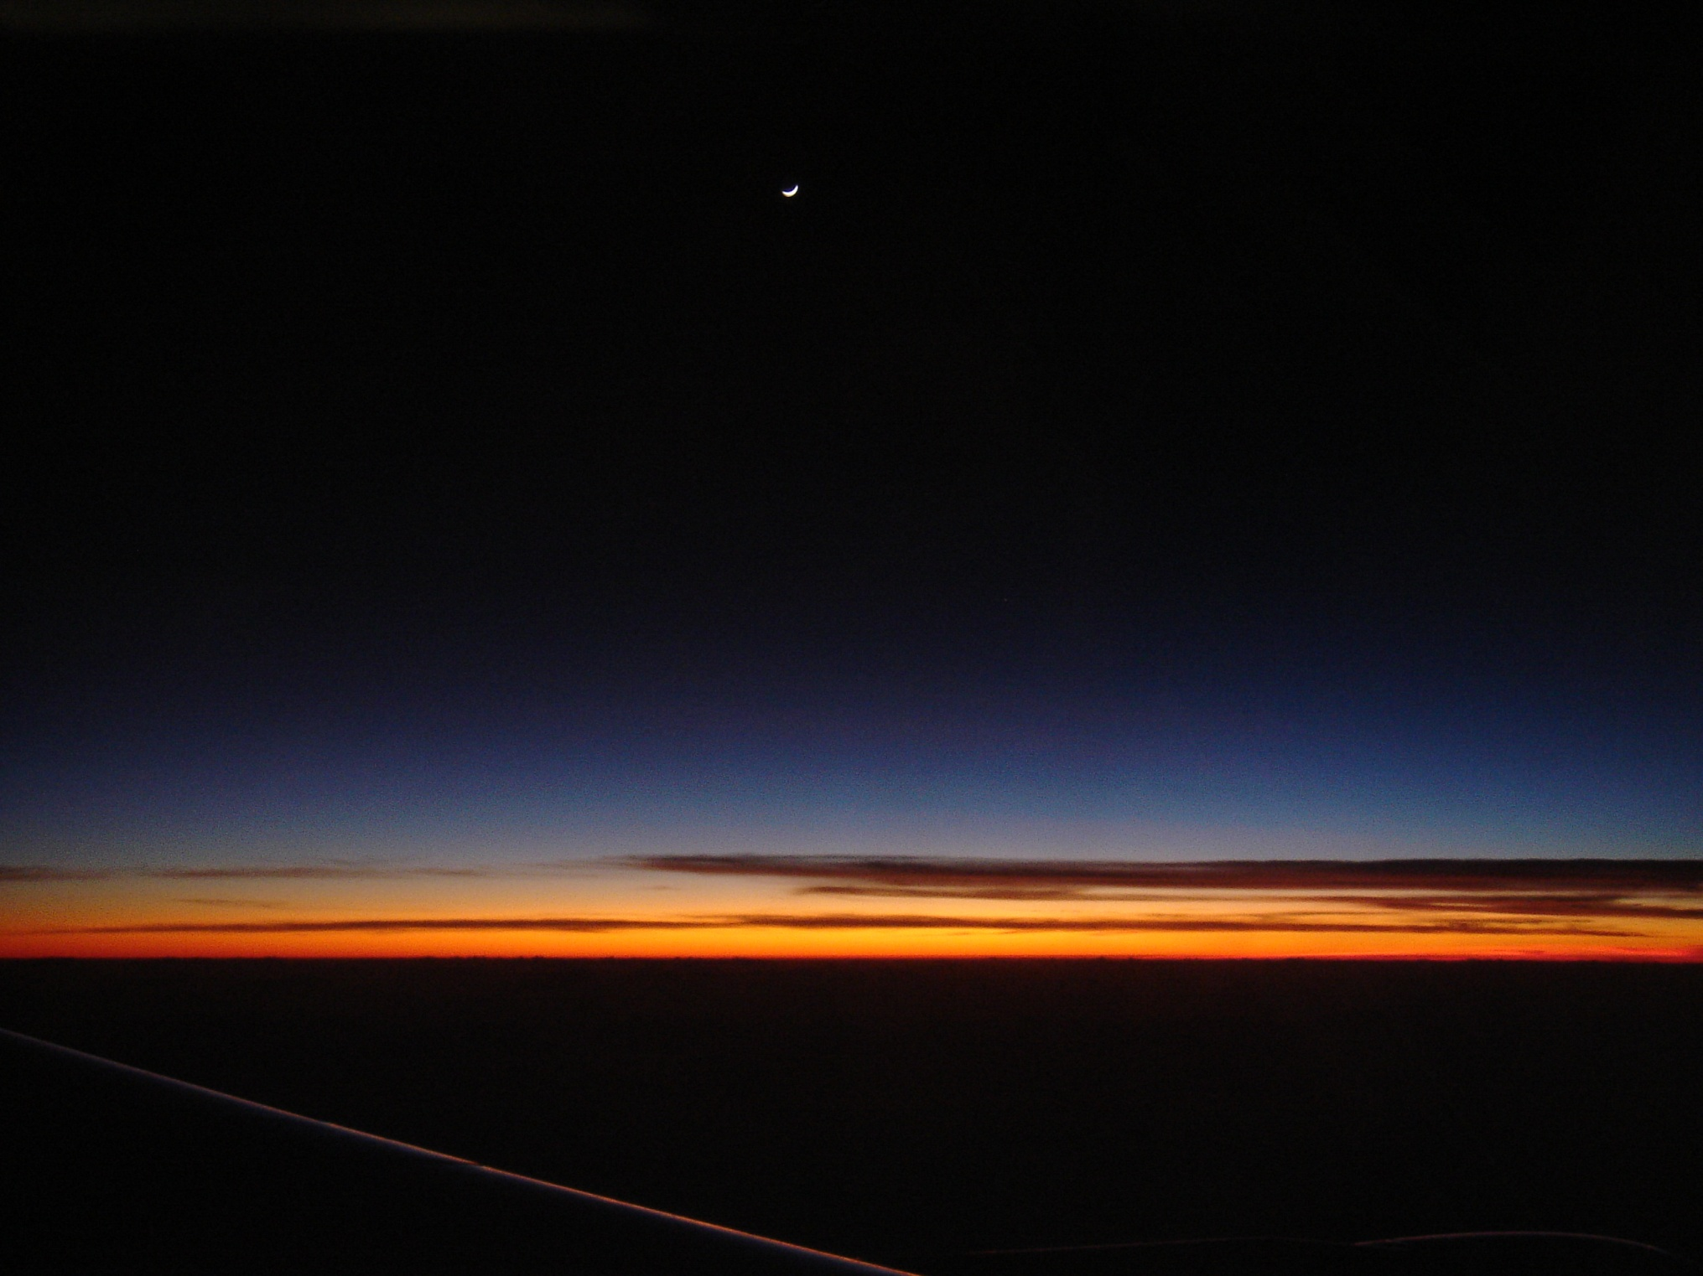
Reflect on a moment when light and darkness, death and life, seemed indistinguishable to you and what this moment taught you.
Notes:
There is a great deal of both darkness and light in our world right now. A lot is in crisis: economic and political systems; the church, religious. Remember that crisis precedes transformation. So much of what is presently in crisis is on its way, however painfully, towards profound transformation.

Slide 6
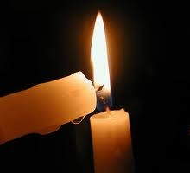
“Let us be a light for each other and not lose heart. Remember, we were made for these times.”
Notes:
Transformation is the work of God’s Spirit. Transformation is beyond our control but dependent upon our cooperation. Like contemplation, It is less something we do and more something that we allow. It has both internal and external dimensions and the two are mysteriously and inextricably intertwined. Transformation has a rhythm and timing of its own but carries within it a sense of urgency. What can help us to allow, to be available for, to cooperate with, and to sustain the process of transformation that God is somehow working in us, in our world, and in our Church during these times? What graces do we seek? How do we live with change in a way that makes us malleable to processes of transformation?

Slide 7
“The accumulated darkness of the ages is dispelled at once by bringing light in, not by trying to chase the darkness out.”
Sri Aurobindo
Notes:
It is a positive, pro-active, forward-moving process of creating. To do so demands that we grow in freedom, that we honor and encourage freedom in one another, because the moment we’re living invites us to risk something new.

Slide 8
“You never change things by fighting the existing reality. To change something, build a new model that makes the existing model obsolete.”
Buckminster Fuller

Slide 9
Compassion

Slide 10
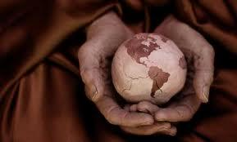
Compassion
Deep awareness of the suffering of another without the need to relieve it, feeling total appreciation for its value; a state of non-judgment.

Slide 11
“Going into places of pain
Being present to pain without closing our hearts
Presence and service to what is within our reach”
Margaret Wheatley

Slide 12
Self Compassion

Slide 13
When [you] look into the heart, may [your] eyes have the kindness and reverence of candlelight…”
(John O’Donohue, excerpt from “To Bless The Space Between Us”)

Slide 14
The Guest House by Rumi
“This being human is a guest house. Every morning a new arrival. A joy, a depression, a meanness, some momentary awareness comes as an unexpected visitor.

Slide 15
Welcome and entertain them all! Even if they’re a crowd of sorrows, who violently sweep your house empty of its furniture, still treat each guest honorably. He may be clearing you out for some new delight.

Slide 16
Jesus: Giving birth to a new humanity
Jn. 16: 20-22
The hour has come:
Jn. 12:23-24
Jn. 17:1-2
Notes:
The Passover of Jesus and the dying/giving
birth that characterizes the whole creation, even the stars.
All creation sustains us.... Are we willing
to participate in the death/birth that sustains ongoing life?

Slide 17
The Passover of Jesus and the dying/giving birth that characterizes the whole creation, even the stars.
All creation sustains us.... Are we willing to participate in the death/birth that sustains ongoing
life?
“If we are not willing to “loose ourselves”, to relate to Life humbly and sensitively with the rest of creation, we cannot survive.”
--Elaine Prevallet, SL

Slide 18
The path is not long
But the way is deep
You must not only walk there
You must be prepared to
leap
Hildegard of Bingen

Slide 19
Given all we have reflected, think in terms of our historical moment of mystical, prophetic religious life.
Where did you feel resonance? Resistance?
What is probably over in religious life?
What might be coming in the future?
What is constant in human life?

